Slide 1
Tic-Tac-Toe using Socket Server
Team members
RA2011003011252 – DIVYANSH GUPTA
RA2011003011248– UTKARSH SABOO
RA2011003011251– ADITYA GIRI GOSWAMI
RA2011003011253– PURVA ATUL TARALE

Slide 2
Content
Objectives
Literature survey
Overview of the project

Slide 3
Objective
This is a simple game of tic-tac-toe developed in Python. It allows two payers to play with one another on different command lines through networking. The server starts the game by first running server.py, waiting for the client to connect by then running client.py. Once their connected, the game itself starts.
The server starts as “X” and goes first, and the client is “O”. The players choose the square would like to use with coordinated: both “A1” and “1A” would be accepted, for example. The game proceeds, with the players taking turns, until one wins or the game is a draw. The host, then the client, is asked whether they’d like a rematch. If both agree, the game starts anew.

Slide 4
Literature survey (min 5 papers content) sample table format given below
S.NO. | Paper Title | Summary | Methodology / Algorithm used
1 | The Socket Programming and Software Design for Communication Based on Client/Server Year of Published: 2009 Published By: IEEE | This paper introduces the application of the client/server(C/S) mode, the concept and the programming principle of the socket based on C/S. | The method of software design for the communication between the client, server-process using the socket mechanism is mainly analyzed, and gives examples of connection-oriented service program. The transmission layer can provide connection oriented to use TCP protocol, connectionless-oriented to use UDP protocol.
2 | A design and implementation of active network socket programming Year of Published: 2002 Published By: IEEE | The concept of programmable nodes and active networks introduces programmability into communication networks. Code and data can be sent and modified on their routes to the destinations. Various research groups have designed and implemented their own design platforms. Each design has its own benefits and drawbacks. Moreover, there exists an interoperability problem among platforms | We introduce a concept that is similar to network socket programming. We intentionally establish a set of simple interfaces for programming active applications. This set of interfaces, known as active network socket programming (ANSP), will be working on top of all other execution environments in the future.
3 | Design and Implementation of Client-Server Based Application Using Socket Programming in a Distributed Computing Environment Year of Published: 2017 Published By: IEEE | This research study discusses the detail overview in developing a client server based application using socket programming in a distributed computing environment. | Interface design, socket programming style, java classes, and exceptions are also considered in the development stage. The communications between client server application processes using socket mechanism were mainly analyzed. The main objective of this research study is to demonstrate the principles and concepts behind socket programming as well as the libraries available in Java.
4 | IP to IP Calling Through Socket Programming Year of Published: 2021 Published By: IEEE | It is used to connect the people in same Wi-Fi network to exchange their communication without having any cost. | First the registration process is designed with which both users are connected. Then calling process is done with IP addresses of both devices using datagram socket programming.
5 | Analysis of Socket Communication Technology Algorithms Under TCP/IP Protocol Year of Published: 2019 Published By: IEEE | When communicating between node machines in different locations in the network virtual lab system, the network layer shields the differences of the lower layer networks and cannot provide uniform data transmission of connectionless packets. Aiming at this problem, a self-correcting and optimal scheduling technique for communication networks based on deep machine learning algorithm is proposed. | The branching algorithm mainly involves enhancing data learning. By using TCP/IP protocol for communication, a method and program implementation of communication using Socket mechanism under TCP/IP protocol are proposed.

Slide 5
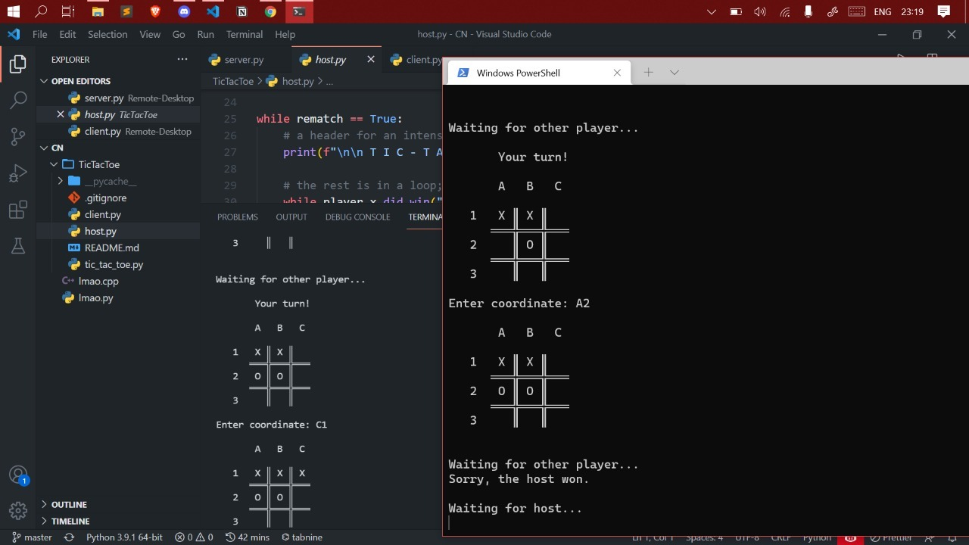
Demo

Slide 6
References
The Socket Programming and Software Design for Communication Based on Client/Server (Year of Published: 2009 Published By: IEEE)
A design and implementation of active network socket programming (Year of Published: 2002 Published By: IEEE)
Design and Implementation of Client-Server Based Application Using Socket Programming in a Distributed Computing Environment (Year of Published: 2017 Published By: IEEE)
IP to IP Calling Through Socket Programming (Year of Published: 2021 Published By: IEEE)
Analysis of Socket Communication Technology Algorithms Under TCP/IP Protocol (Year of Published: 2019 Published By: IEEE)

